Slide 1
A Tutorial on Graph-Based SLAM
Jaeman Han

Slide 2
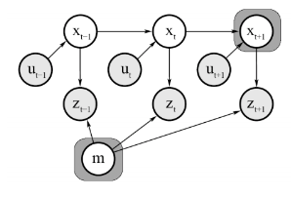
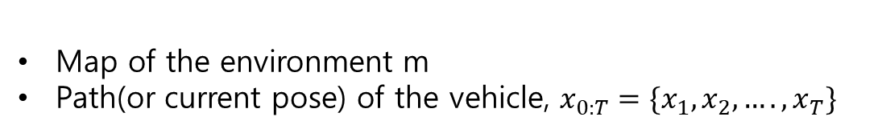
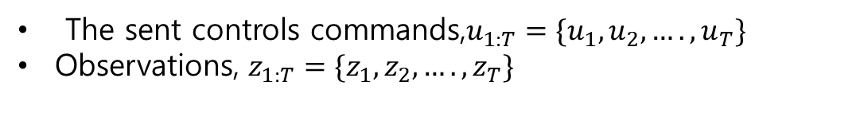
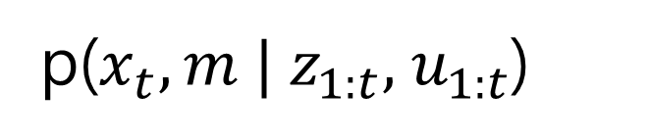
Introduction
Filtering SLAM
-the filtering approaches are usually referred to as on-line SLAM methods
Given
The sent controls commands,$u_{1:T}=\{u_{1},u_{2},….,u_{T}\}$
Observations, $z_{1:T}=\{z_{1},z_{2},….,z_{T}\}$
Wanted
Map of the environment m
Path(or current pose) of the vehicle, $x_{0:T}=\{x_{1},x_{2},….,x_{T}\}$
p($x_{t},m | z_{1:t},{ u}_{1:t}$)

Slide 3
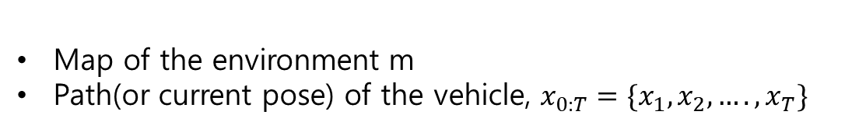
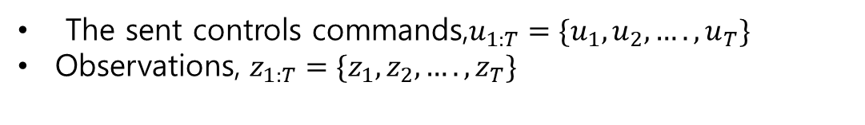
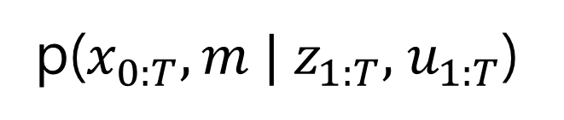
Introduction
Smoothing SLAM
-full trajectories one estimated using complete set of measurements
-smoothing slam(offline slam) estimates the entire path
-After obtaining all sensor data, create a map and proceed with optimization
Given
The sent controls commands,$u_{1:T}=\{u_{1},u_{2},….,u_{T}\}$
Observations, $z_{1:T}=\{z_{1},z_{2},….,z_{T}\}$
Wanted
Map of the environment m
Path(or current pose) of the vehicle, $x_{0:T}=\{x_{1},x_{2},….,x_{T}\}$
p($x_{0:T},m | z_{1:T},{ u}_{1:T}$)

Slide 4




Idea of Graph-Based SLAM
Modeling
Use a graph to represent the problem
Every node in the graph corresponds to a pose of the robot during mapping
Every edge between two nodes corresponds to a spatial constraint between them
Node
Node
Node
$$x_{i}$$
Edge
$$x_{i+1}$$
$$z_{i}$$
Front End &Back End
Front End -Build pose graph by matching sensor data
Back End -Optimize poses using Least Square Method

Slide 5


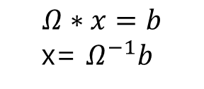









1D Example of Graph Based SLAM
assume linear
Front End
Back End
$x_{0 }$ $x_{1}$ $x_{2}$
$$x_{0}$$
$$x_{1}$$
$$x_{2}$$
$$x_{0 }$$
$$\begin{matrix}x_{0} \\ x_{1} \\ x_{2}\end{matrix}$$
$$x_{1 }$$
Initial position: -3
$1^{st}$movement: 5
$2^{nd}$movement: 3
$$x_{2 }$$
Information matrix
Pose
Vector
Information vector
$( Ω$ )
(x)
pose
$$Ω∗x=b$$
x= $Ω^{−1}b$

Slide 6
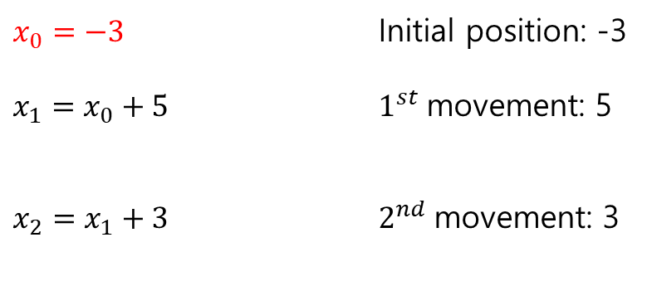
1D Example of Graph Based SLAM
Front End
Back End
$x_{0 }$ $x_{1}$ $x_{2}$
$$x_{0}$$
$$x_{1}$$
$$x_{2}$$
$$x_{0 }$$
1
-3
$$\begin{matrix}x_{0} \\ x_{1} \\ x_{2}\end{matrix}$$
$$x_{1 }$$
$x_{0}=−3$ Initial position: -3
$x_{1}=x_{0}+5$ $1^{st}$movement: 5
$x_{2}=x_{1}+3$ $2^{nd}$movement: 3
$$x_{2 }$$
Information matrix
Pose
Vector
Information vector
$( Ω$ )
(x)
pose
$$Ω∗x=b$$
x= $Ω^{−1}b$

Slide 7

1D Example of Graph Based SLAM
Front End
Back End
$x_{0 }$ $x_{1}$ $x_{2}$
$$x_{0}$$
$$x_{1}$$
$$x_{2}$$
$$x_{0 }$$
-1
-8
2
$$\begin{matrix}x_{0} \\ x_{1} \\ x_{2}\end{matrix}$$
$$x_{1 }$$
-1
1
5
$x_{0}=−3$ $x_{0}−x_{1}=−5$
$x_{1}=x_{0}+5$ $−x_{0}+x_{1}$=5
$x_{2}=x_{1}+3$
$$x_{2 }$$
Information matrix
Pose
Vector
Information vector
$( Ω$ )
(x)
pose
$$Ω∗x=b$$
x= $Ω^{−1}b$

Slide 8

1D Example of Graph Based SLAM
Front End
Back End
$x_{0 }$ $x_{1}$ $x_{2}$
$$x_{0}$$
$$x_{1}$$
$$x_{2}$$
$$x_{0 }$$
2
-8
-1
$$\begin{matrix}x_{0} \\ x_{1} \\ x_{2}\end{matrix}$$
$$x_{1 }$$
-1
2
-1
2
$x_{0}=−3$ $x_{1}−x_{2}=−3$
$x_{1}=x_{0}+5$ $−x_{1}+x_{2}$=3
$x_{2}=x_{1}+3$
$$x_{2 }$$
-1
1
3
Information matrix
Pose
Vector
Information vector
pose

Slide 9










1D Example of Graph Based SLAM
assume linear
$$μ$$
$$Ω^{−1}$$
$$ξ$$
$$=$$
$$x_{0}$$
$$x_{1}$$
$$x_{2}$$
$$x_{0}=−3$$
$$x_{1}=x_{0}+5$$
${ x}_{2}=x_{1}+3$
$x_{0 }$ $x_{1}$ $x_{2}$
$$x_{0 }$$
2
-1
0
-3
$$x_{1 }$$
-1
2
-1
2
$( Ω$ )
$$x_{2 }$$
0
-1
1
5
pose
Information matrix
Information vector

Slide 10

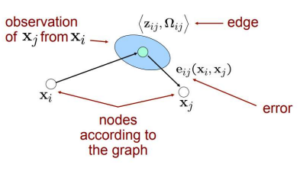



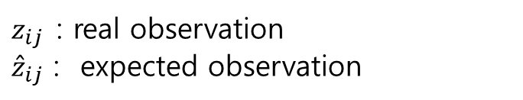

How to build pose graph
Constraint
The log-likelihood $l_{ij}$ of a measurement $z_{ij}$
$z_{ij}$: real observation
${\hat{z}}_{ij}$ : expected observation
$Ω_{ij}$=${(cov)}^{−1}$

Slide 11



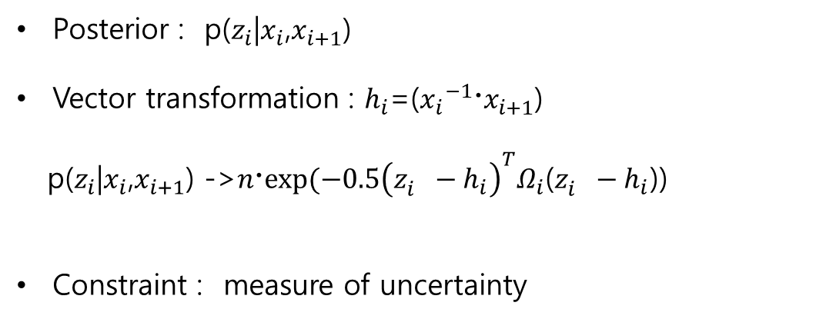
Probabilistic meaning of Graph Optimization-MAP(Maximize A Posterior)
Posterior : p($z_{i}$|$x_{i}$,$x_{i+1}$)
Vector transformation : $h_{i}$=(${x_{i}}^{−1}〮x_{i+1}$)
p($z_{i}$|$x_{i}$,$x_{i+1}$) ->$n〮exp⁡(−0.5{\left(z_{i}^{}−h_{i}\right)}^{T}Ω_{i}\text{(}z_{i}^{}−h_{i}\text{)}\text{) }$
Constraint : measure of uncertainty

Slide 12



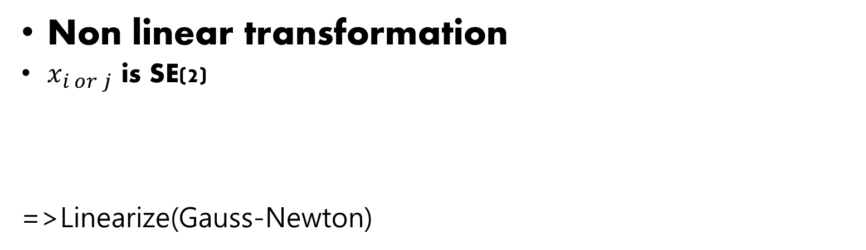

Least Square Method in SLAM
Non linear transformation
$x_{i or j}$ is SE(2)
=>Linearize(Gauss-Newton)
Find $Δx$
$x_{0}$ -> $x_{0}$+ $Δx_{0}$
$x_{1}$ -> $x_{1}$+ $Δx_{1}$
$x_{n}$ -> $x_{n}$+ $Δx_{n}$
…….

Slide 13


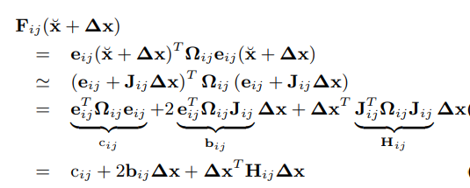



Error Minimization via Iterative Local Linearizations
If a good initial guess $\breve{x}$ of the robot’s poses is known
approximate the error function by its first order Taylor expansion around the current initial guess $\breve{x}$
$J_{ij}$ is Jacobian of $e_{ij}(x)$
in the error terms $F_{ij}$ of F(x)->

Slide 14
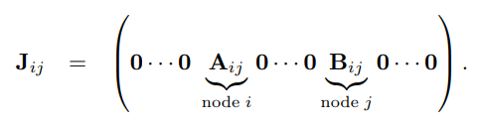
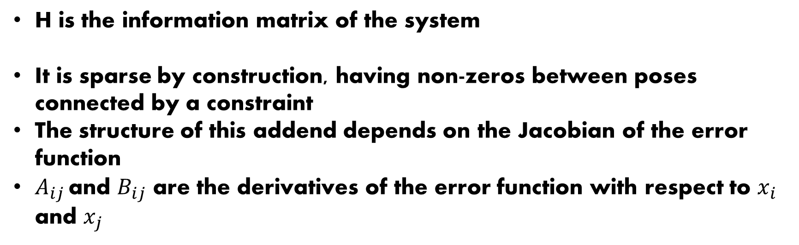
Considerations about the Structure of the Linearized System
H is the information matrix of the system
It is sparse by construction, having non-zeros between poses connected by a constraint
The structure of this addend depends on the Jacobian of the error function
$A_{ij }$and $B_{ij}$ are the derivatives of the error function with respect to $x_{i}$ and $x_{j}$

Slide 15
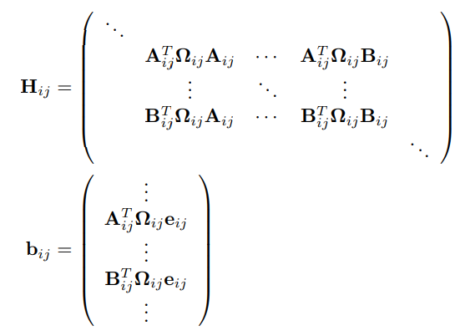
Considerations about the Structure of the Linearized System
we obtain the following structure for the block matrix $H_{ij}$

Slide 16
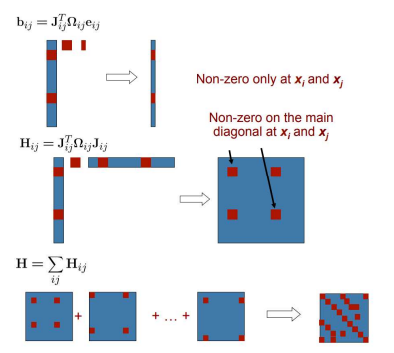
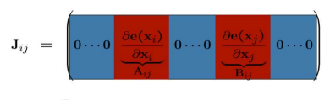
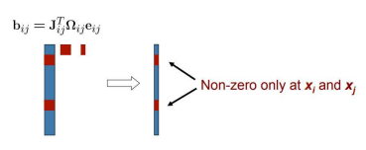
Considerations about the Structure of the Linearized System

Slide 17
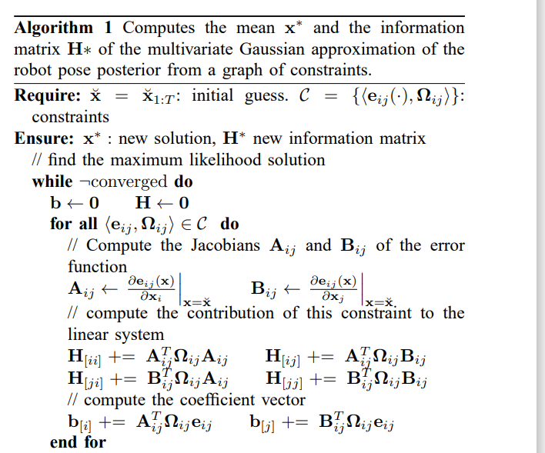
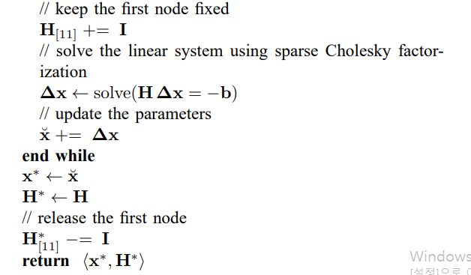


Algorithm
$$Δx_{1}=0$$
$$H_{11}+1$$

Slide 18
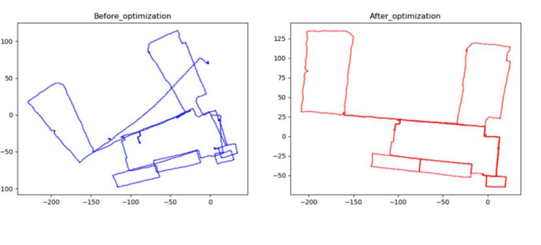
result

Slide 19
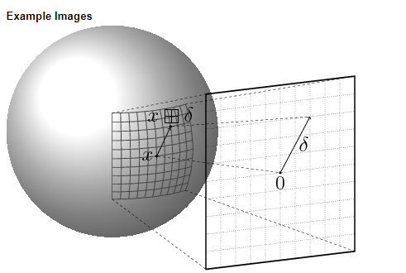
Least Squares on a Manifold
NonEuclidean 2D or 3D rotation group SO(2) or SO(3).
The singularities in the 2D case can be easily recovered by normalizing the angle, however in 3D this procedure is not straightforward.
A manifold is a mathematical space that is not necessarily Euclidean on a global scale, but can be seen as Euclidean on a local scale

Slide 20

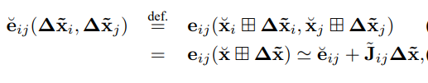

Least Squares on a Manifold
Define an operator that maps a local variation $Δx$ in Euclidean space to a variation on the manifold.

Slide 21
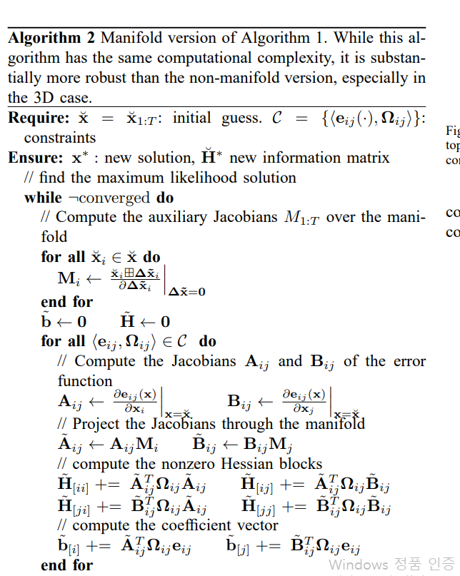
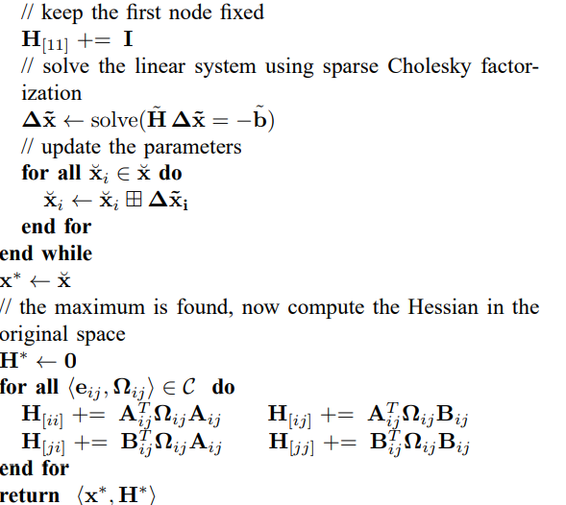
Algorithm

Slide 22
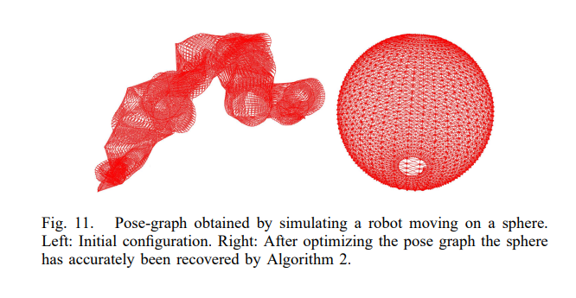
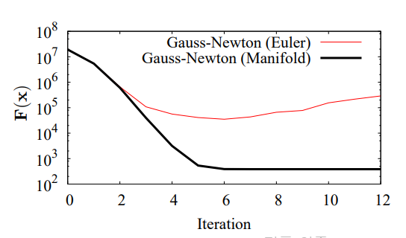
Result

Slide 23
Q&A

